Slide 1
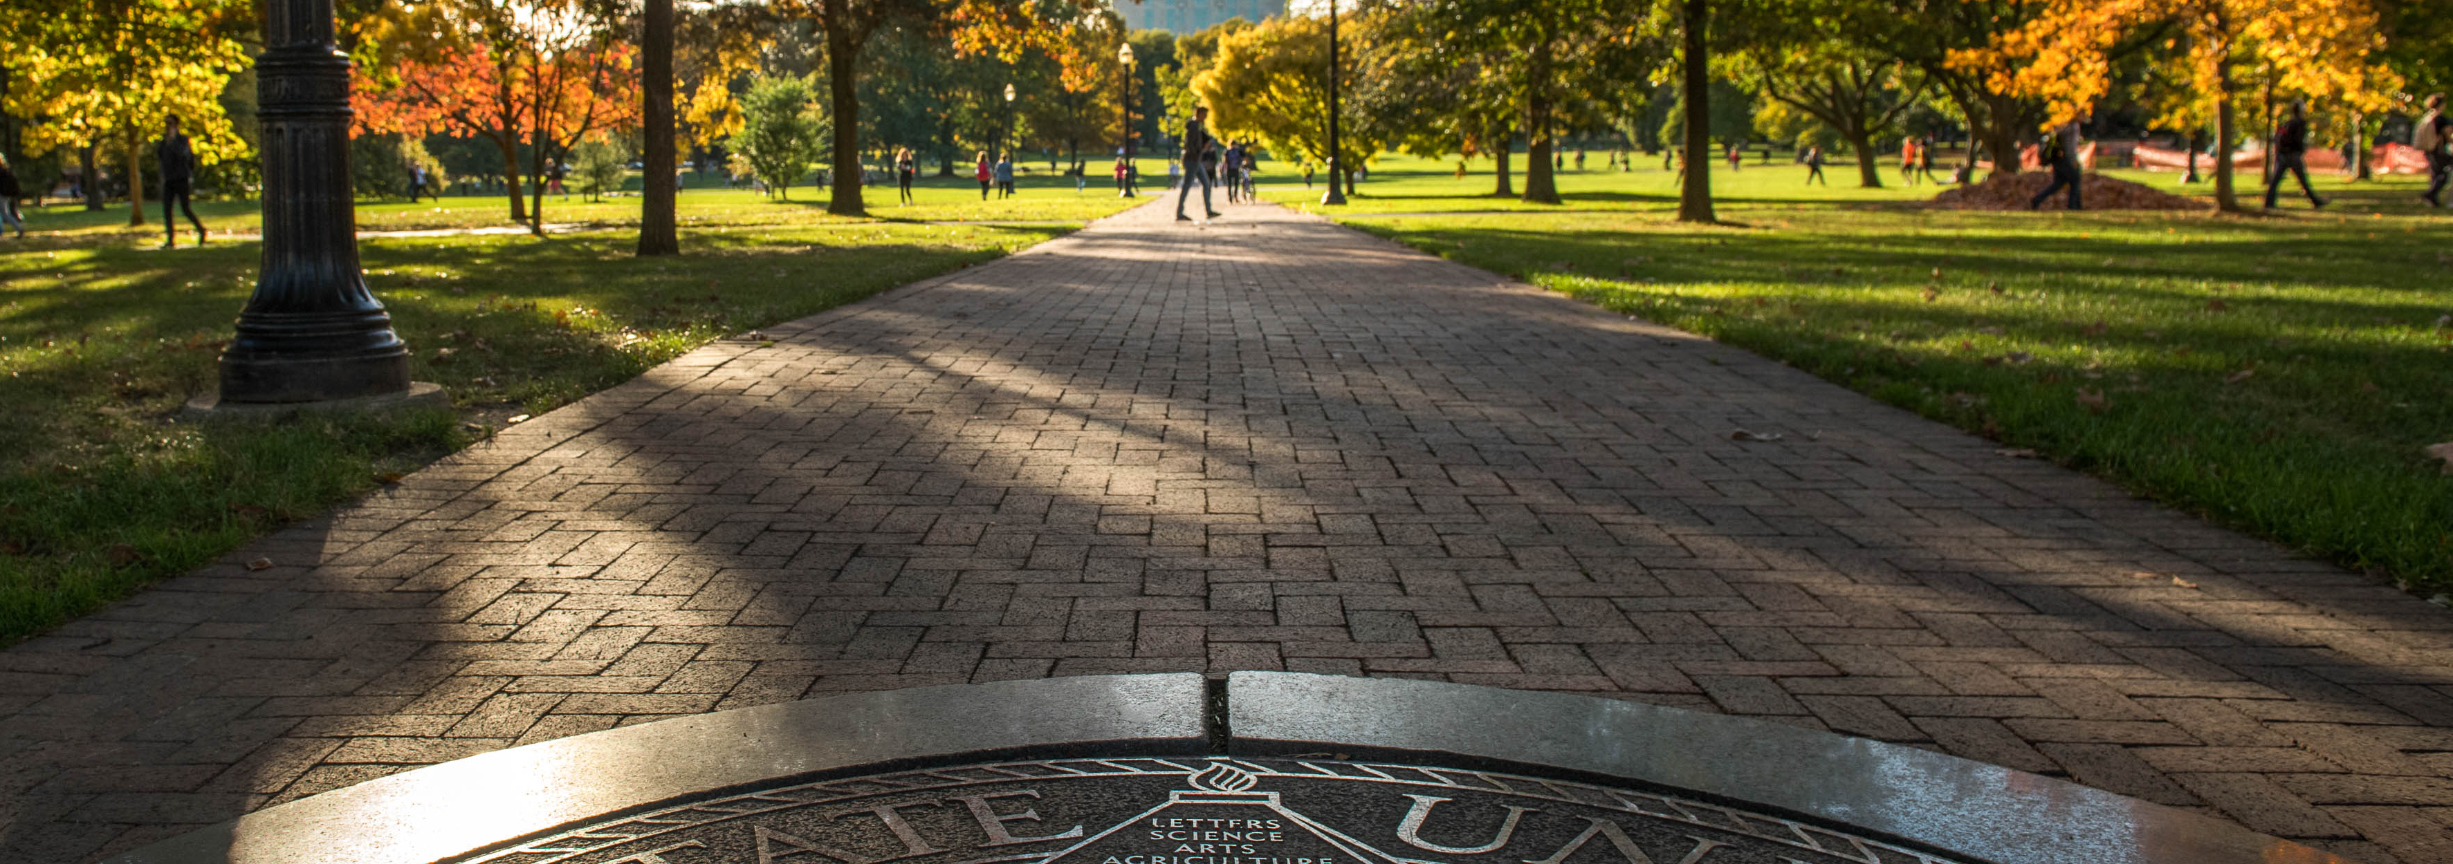
SB 1 Compliance Overview

Slide 2

Advance Ohio Higher Education Act (SB 1)
SB 1 took effect June 27, 2025.
A university-wide committee has developed implementation guidance in collaboration with teams of faculty, staff and students.
Information about more provisions and policies is available on go.osu.edu/SB1.

Slide 3
What SB 1 does NOT do:
SB 1 does not restrict the freedom of faculty to teach, conduct research or publish research findings or to discuss in classrooms, in their own manner, any material that is relevant to the subject matter as defined in the course syllabus.
This covers all aspects of intellectual endeavor – including faculty, instructors and GTAs.
SB 1 also does not prohibit controversial issues from being discussed in class, though it does require the university to “ensure the fullest degree of intellectual diversity” to allow students to reach their own conclusions.
University’s academic rights and responsibility resources: https://oaa.osu.edu/resources/academic-rights-and-responsibilities.

Slide 4
What Does SB 1 do?

Slide 5
Institutional Neutrality
SB 1 prevents universities from taking institutional positions on controversial political or global matters that extend beyond the university’s operations.
Consistent with Ohio State’s Philosophy on Institutional and Leadership Statements.
Philosophy updated with more guidance on who it applies to, what constitutes an institutional statement, and land acknowledgement statements.
The philosophy does not apply to academic teaching and research activities or students in their student capacity.

Slide 6

Intellectual Diversity
SB 1 does not prohibit controversial issues from being discussed in classes but requires the university to:
  “ensure the fullest degree of intellectual diversity” in courses
  allow students to reach their own conclusions around controversial issues.
Syllabus Statement

Slide 7
Classroom Discussion
FAQs
Best Practices
  Set expectations at the start of the course and remind students throughout
  Model openness and freedom of expression
  Balance perspectives and analysis, particularly on controversial or contested topics and subject matter
  Ask your peers for advice
  Use your professional judgment
  Be confident…..and open to acknowledging that errors are possible

Slide 8

Additional Policies
SB 1 requires the Board of Trustees to enact and update several policies, including faculty annual review, post-tenure review process and updated workload policies.
Annual Review
Post-Tenure Review
Faculty Workload Guidelines

Slide 9
DEI Prohibitions
SB 1 defines “protected class” as race, ethnicity, national origin, sex, sexual orientation, gender identity, gender expression, or religion.
These prohibitions do not restrict the freedom of faculty to teach, conduct research and publish research findings or to discuss in classrooms, in their own manner, any material that is relevant to the subject matter within an academic discipline as defined in the course syllabus.

Slide 10
Protected class prohibitions
SB 1 prohibits anything that is “for” or “intended to benefit” or “especially appropriate for” one or more protected class groups. Specifically:
  Any orientation or training course regarding diversity, equity, and inclusion.
  Diversity, equity, and inclusion offices or departments.
  Using diversity, equity, and inclusion in job descriptions.
  Titles/positions of Chief Diversity Officer or Diversity Officer.
  Contracting with anyone whose role is or would be to promote admissions, hiring, or promotion based on the specified protected classes.
  New scholarships that use diversity, equity, and inclusion in any manner.
  Merely changing the name of any DEI office, department, orientation, training, or position while continuing to “serve the same or similar purposes,” or use “the same or similar means.”

Slide 11

Complaint and Reporting Process
SB 1 requires the university to address complaints alleging SB1 violations in the same manner that it addresses complaints alleging violations of the Campus Free Speech policy.
The university created an SB1 complaint process that mirrors the campus free speech complaint process, references the rights SB 1 affords to members of our community and describes how they can file a complaint.

Slide 12

Hiring and Admissions
The university has updated its admissions and hiring policies in a way that complies with SB 1.
The Office of Human Resources, the Office of Academic Affairs, and the Office of Legal Affairs have also worked to review and update faculty and staff hiring processes (e.g., removal of diversity statements in hiring) to reflect the additional requirements in these sections.

Slide 13
Partnerships with China
The law requires new processes for evaluating academic partnerships with and donations/contributions from the People’s Republic of China (PRC).
SB 1 prohibits gifts, donations, and contributions from the PRC.
Faculty will no longer be allowed to accept federal funding from the PRC.
Any new or renewed partnership must be reported to the Chancellor of ODHE if the partnering academic or research institution is located in China.

Slide 14
Additional Provisions
Invited Speakers
Monthly posting of university-sponsored speakers paid more than $500
Statement of Commitment
Legislatively-defined language that must appear with university mission statement
Included in all offers of admission to students and offers of employment to faculty
Low-Enrollment Degrees
Current students in any degree program will be able to finish their degree
Degree enrollments will be reviewed annually

Slide 15

2026 Provisions
By Autumn 2026:
Accessible syllabi
Required American government or history course

Slide 16
Resources
Office of Faculty Affairs/Office hours – weekly on Fridays throughout the semester beginning August 29. More information available on Faculty Affairs website.
SB 1 Compliance website – will be updated as new information or additional guidance is developed
One-pager
Center for Ethics and Human Values – guide for facilitating civil discourse in the classroom
The Drake Institute for Teaching and Learning

Slide 17
Questions?

